Slide 1

Guidelines LRCAP 2026 Energy Storage November | 2025

Slide 2



LRCAP 2026 – Storage
Overview | What deadline(s)?
The Ministry of Mines and Energy (MME) published, through Ordinance No. 878, of November 7, 2025, a Public Consultation, to establish the guidelines and systems for holding the first auction for contracting battery energy storage systems (“BESS”), scheduled to be held in April 2026.
Reserve Capacity Auction in the form of Power (“LRCAP”) will allow companies to operate BESS to store and release energy when needed.
ANEEL is responsible for preparing (i) the public notice; (ii) its annexes; (iii) Reserve Capacity Power Contracts (CRCAPs); and (iv) any other necessary acts and measures.
Public Consultation N° 202 10/11/2025 | Term _ Open for contribution until 01.12.2025
1st LRCAP Storage (2026) | Term _ Auction. Scheduled to be held in April 2026 – exact date TBD. _ Beginning of Supply. Projects of successful bidders must start power delivery on 08.01.2028. _ Contract Term. 10 years *The anticipation of the projects’ COD may occur, provided that the benefits related to such anticipation to the National Interconnected System – SIN are demonstrated.

Slide 3


LRCAP 2026 – Storage
Overview | Bidders and Auction Winners
Which companies can participate?
Minimum Power: greater than or equal to 30 MW;
Operating capacity: at least 4 consecutive hours of maximum power;
Battery storage systems: thermoelectric projects with a variable unit cost (Custo Variável Unitário – CVU) equal to zero;
Minimum loading and unloading efficiency: greater than or equal to 85%;
Maximum recharge time: 6 hours;
Companies that: (a) are directly connected to the SIN or (b) share connection points; and
Technical Note NT-ONS DPL 0111/2025: meet the technical requirements set forth in Technical Note NT-ONS DPL 0111/2025.
Criteria for Selecting Auction Winners
Lowest Bid Price (R$/MW. Year): the successful bid shall be the one which presents lowest price of the remaining flow capacity of the SIN.
Tie-break criteria: (i) lowest power amount offered; and (ii) chronological order of submission of the bid.

Slide 4



LRCAP 2026 – Storage
Overview | Remuneration
Remuneration Model | Annual Fixed Revenue (R$/year). Payment in 12 monthly installments, which can be reduced according to the calculation of operating performance in previous months.
Remuneration Basis | Investment and operating costs (rate of return); Environmental and decommissioning obligations; Connection and use of the transmission and distribution system; and Taxes, Regulatory and Operational Costs and Sector Charges. *Reductions in revenue: (a) applied due to unavailability, (b) non-compliance with power delivery or (c) National System Operator (“ONS”) dispatch.
Who will be responsible for paying for the energy | CONCAP (Power Account for Reserve Capacity). CONCAP pays for charging energy limited by efficiency, based on the settlement made in the Short-Term Market (“MCP”) to the Spot Price (“PLD”); and Agents. Agents pay for the surplus consumption of electricity beyond the limit proportional to efficiency.

Slide 5



LRCAP 2026 – Storage
Overview | Licenses, Access Opinion and Bonus
Environmental Licenses | Preliminary, Installation and Operation Licenses not required for technical qualification. *The Notice will define the deadline for obtaining the environmental licensing of the winning projects.
Access Opinion (Parecer de Acesso) | Enterprises connected to the Basic Network, Other Power Transmission Facilities (“DIT”) or Transmission Facility for the Exclusive Use of Generation Plants under a Shared Connection (“ICG”) are exempt from submitting the corresponding Acess Opinion.
Location Bonus | Price reduction for priority points: (i) ONS and Energy Research Company (“EPE”) will identify connection points in the SIN that offer additional systemic benefits; and (ii) a positive adjustment (bonus constant) will be applied to increase competitiveness.

Slide 6

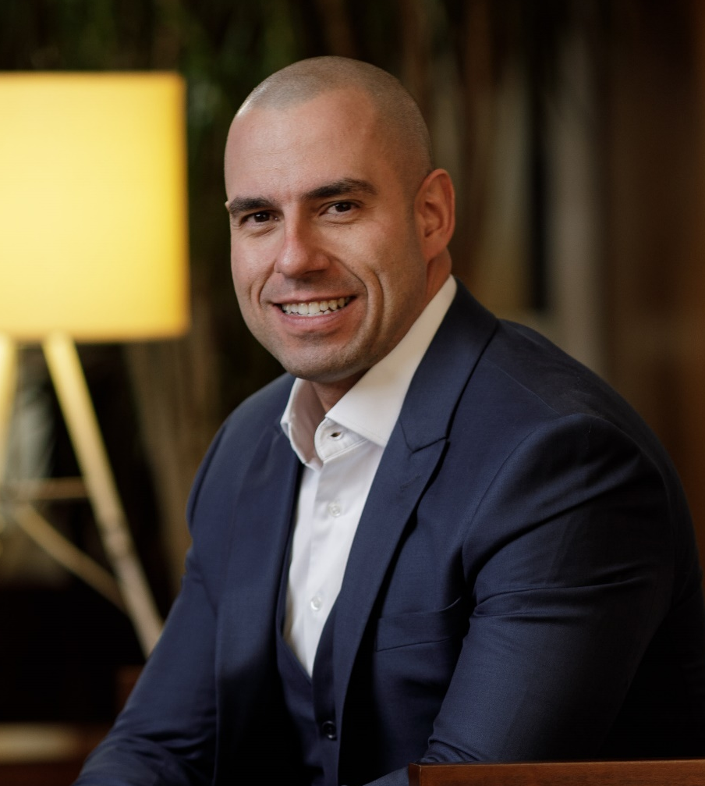

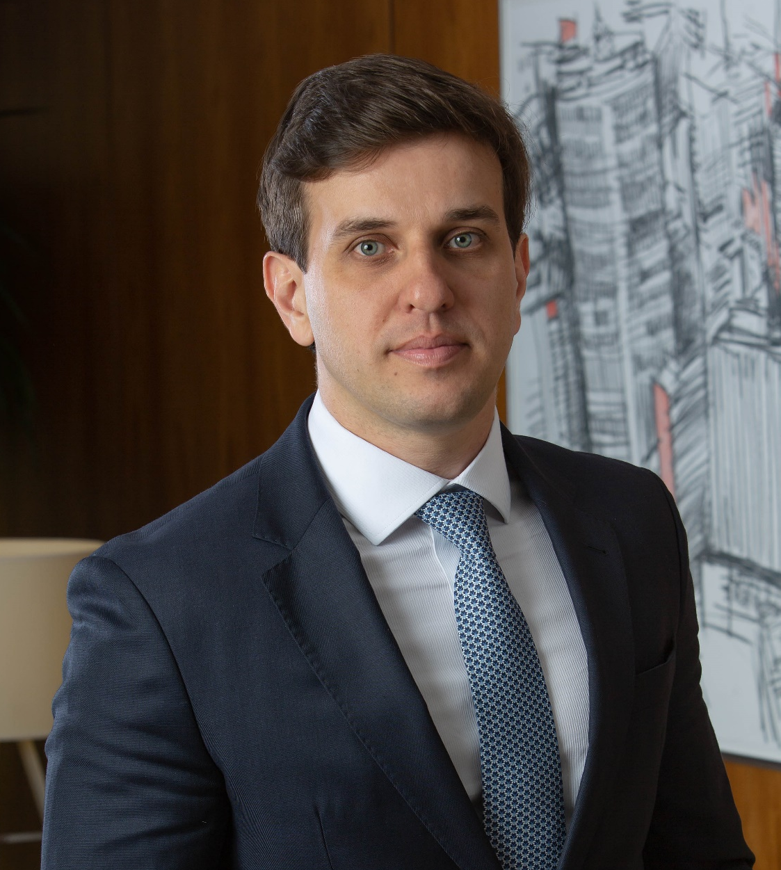
To learn more about the reform of the electricity sector and other related topics, please contact our experts
Rafael Gomes
Partner
raphael.gomes@lefosse.com
Pedro Dante
Partner
pedro.dante@lefosse.com
Bruno Crispim
Partner
bruno.crispim@lefosse.com

